Slide 1
Performance indices
Regression
Jean Christophe Meunier
January the 4th 2021, Becode AI/data science bootcamp

Slide 2
Error-based indicators

Slide 3
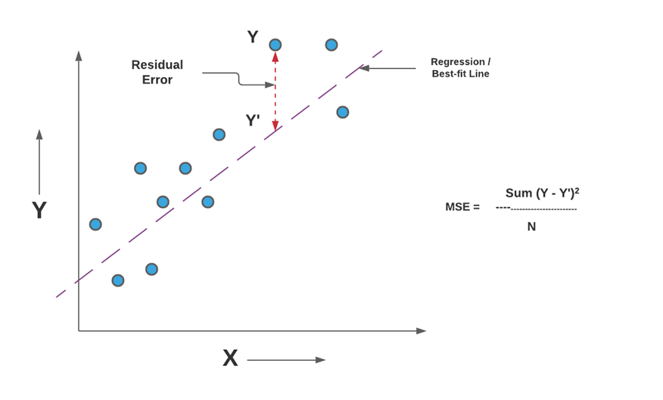
Characteristics
Distance observed (y) -- predicted (y’ or ŷ)
The lower the best
Not readily interpretable, but useful :
For comparing nested models (error is data set dependent)
In conjunction with other indicators
Many indicators :
E.g. MAE, MSE, RMSE, MPE, MPA,..
Each of them covering different aspects : amount of error, bias, specific outliers,…

Slide 4

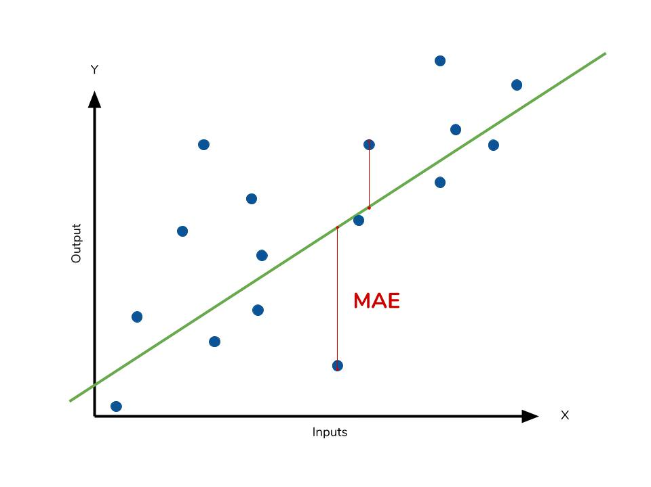
Mean absolute error (MAE)
Absolute distance :
+ and – distance do not cancel each other out
Typical magnitude of the residuals
Same metric as variable of interest

Slide 5

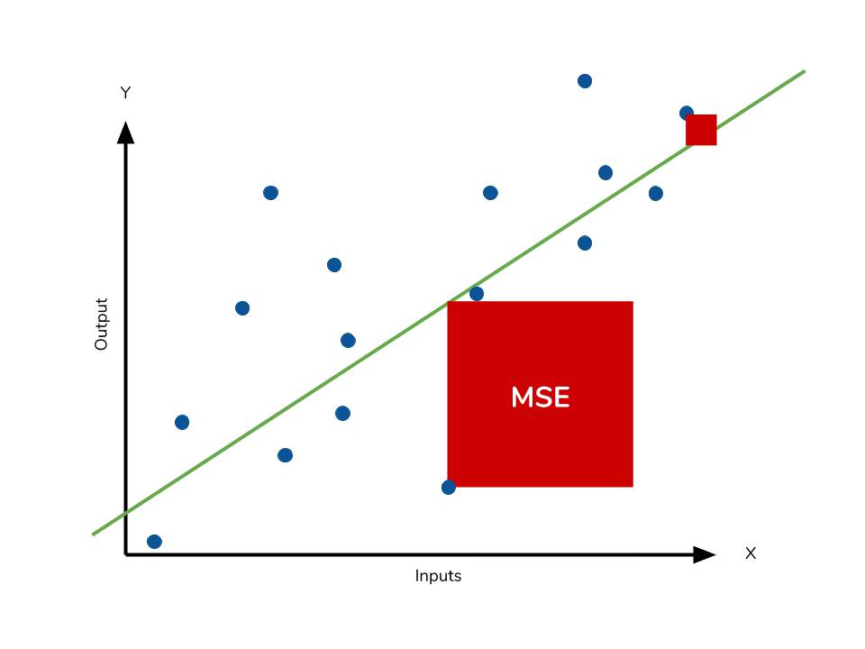
Root Mean Squared Error (RMSE)
Distance ‘manipulation’ :
Squared :
- and + do not cancel each other out
larger error are exponentially weighted
Square root :
Turn back in the same metric as variable of interest

Slide 6
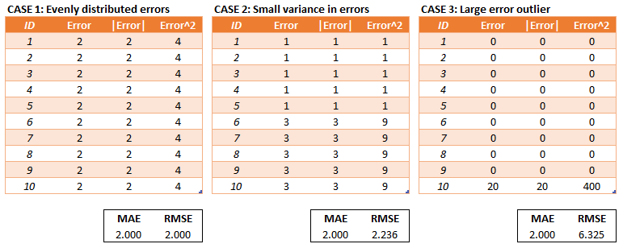
MAE vs. RMSE
MAE
Easier to interpret (distance is not ‘manipulated’)
Errors contribute linearly to the overall error
RMSE
More useful when large errors are particularly undesirable (outliers)

Slide 7
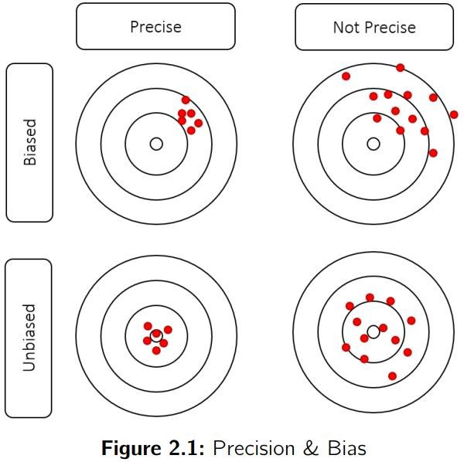
MAE vs. RMSE
Both provide information on amount of error but not on bias
X
with |abs| and ()²
+ and – distances are no longer identifiable

Slide 8
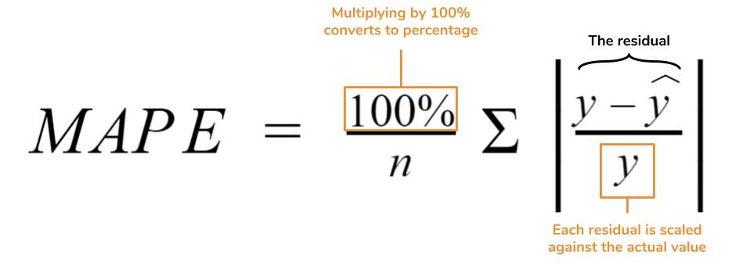
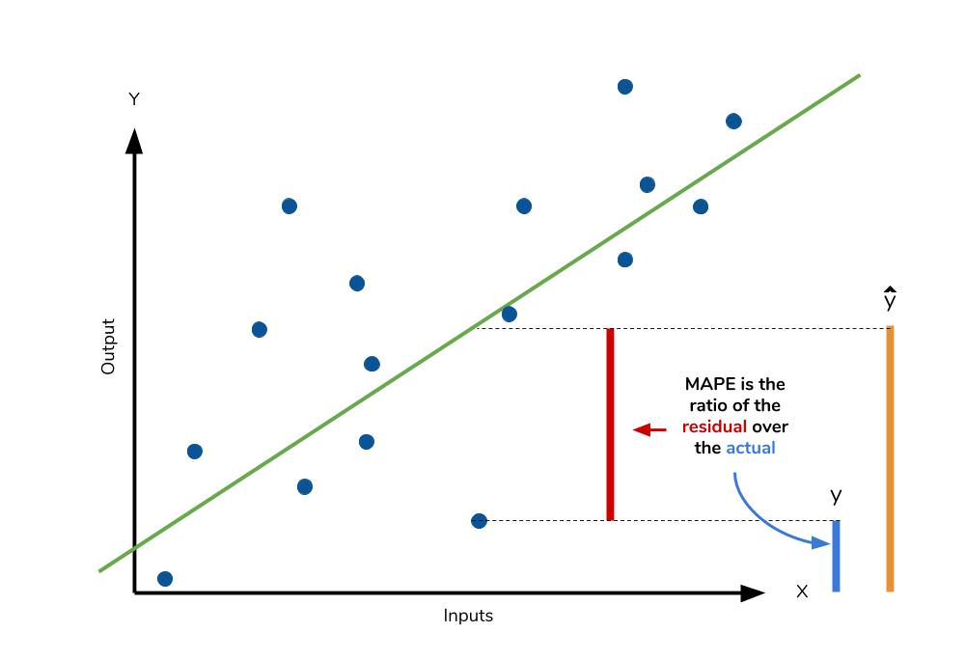
Mean Absolute Percentage of Error (MAPE)
Average proportion of error
Ex: ŷ = 11 vs. y = 10 indicates a 10% error
Independent of the metric
Ex : 1 vs. 10 same as 100 vs. 1000
Absolute value
- and + distances do not cancel each other out

Slide 9
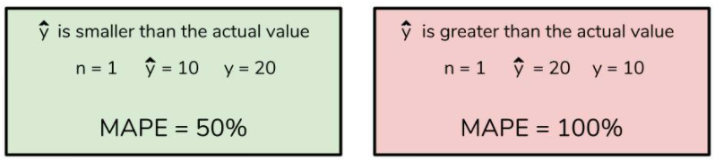
Mean Absolute Percentage of Error (MAPE)
Average proportion of error
Ex: ŷ = 11 vs. y = 10 indicates a 10% error
Independent of the metric
Ex : 1 vs. 10 same as 100 vs. 1000
Absolute value
- and + distances do not cancel each other out
Weakness of MAPE: predictions that are systematically
either higher or lower are not equally weighted
MAPE >>>
MAPE <<<

Slide 10
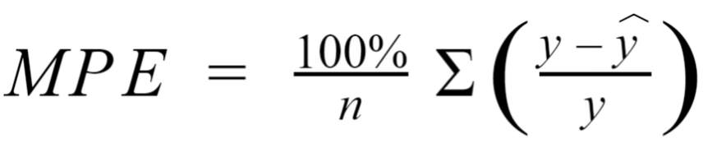
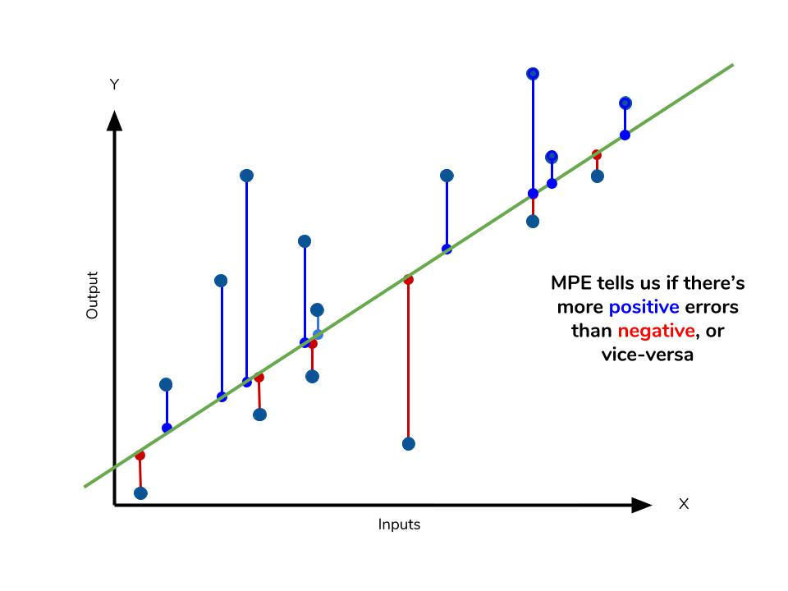
Mean Percentage of Error (MPE)
Same as MAPE but without |abs|
+ and – canceled out
No information on performance
Identify bias
underestimation (more negative error)
overestimation (more positive error)

Slide 11
Mean Percentage of Error (MPE)
Provide information on bias but not on amount of error
X
without |abs|
+ and – distances are now identifiable

Slide 12
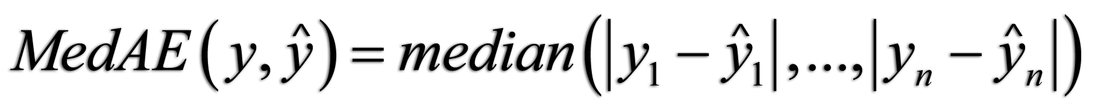

Alternative indicators
Median absolute error
Not affected by outliers
Max error
worst case error between the predicted value and the true value

Slide 13
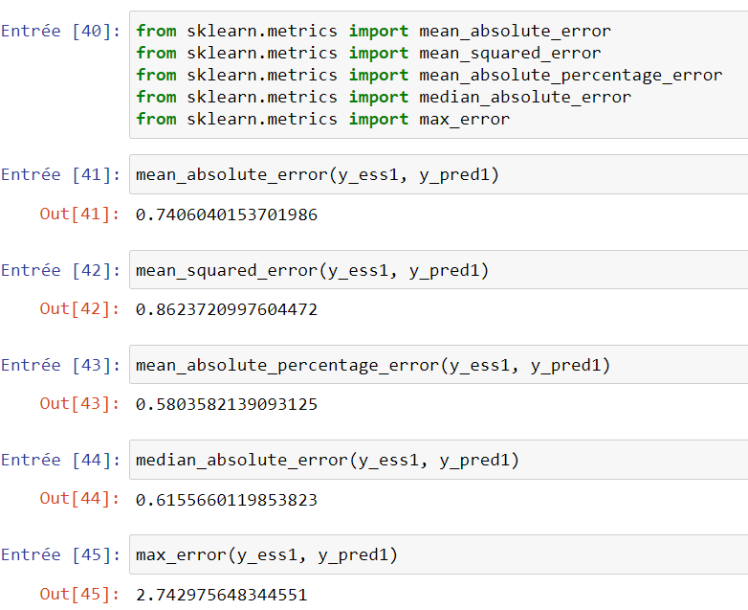
Sklearn
Rem:
Mean percentage error (MPE) not available in sklearn
New in sklearn 0,24

Slide 14
Scores
Based on explained variance

Slide 15
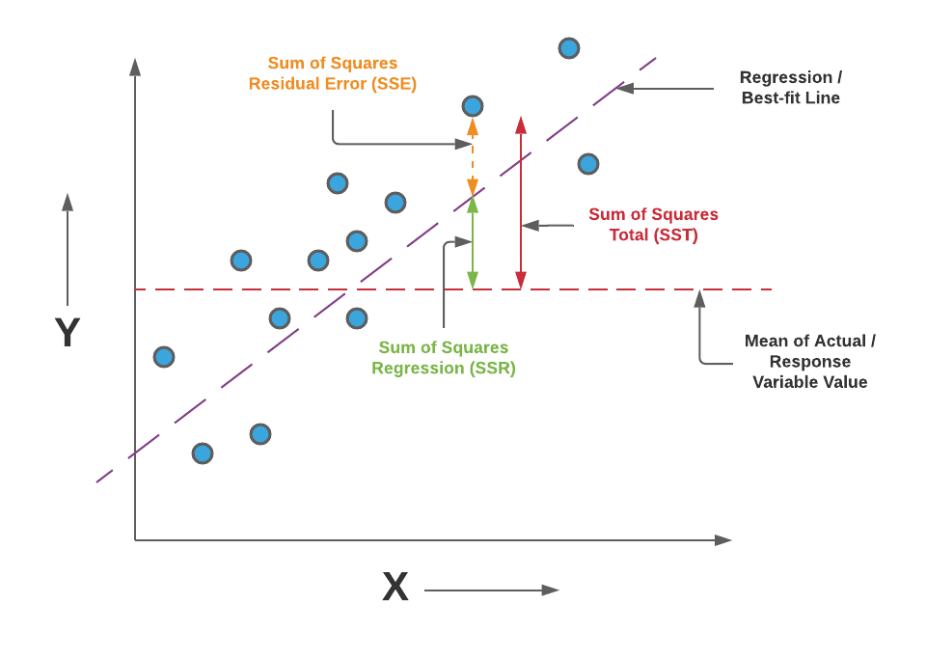


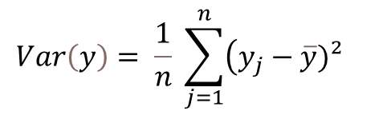
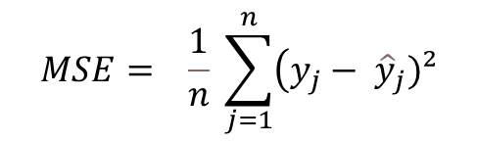
Characteristics
Residual MSE regression
MSE baseline = Var(y)
Part of the
‘MSE baseline = Var(y)’
explained by regression
MSE Comparison between
Regression model
Baseline inept model
Predict nothing but the mean : ŷ always = $\overline{y}$
In this case MSE is stricly equal to Var(y)
$$\overline{y}$$
$$MSE= \frac{1}{n} \sum_{j=1}^{n}{\left(y_{j}− {\hat{y}}_{j})²\right.}$$
=
$$Var\left(y\right)= \frac{1}{n} \sum_{j=1}^{n}{\left(y_{j}−\overline{y})² \right.}$$

Slide 16
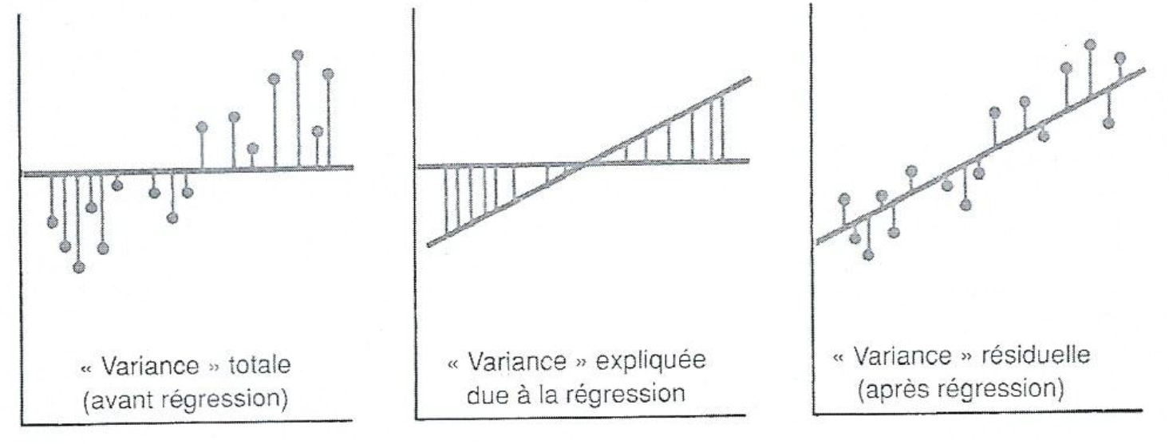
Characteristics
Residual MSE regression
MSE baseline = Var(y)
Part of the
‘MSE baseline = Var(y)’
explained by regression
MSE Comparison between
Regression model
Baseline inept model
Predict nothing but the mean : ŷ always = $\overline{y}$
In this case MSE is stricly equal to Var(y)

Slide 17
Characteristics
Residual MSE regression
MSE baseline = Var(y)
Part of the
‘MSE baseline = Var(y)’
explained by regression
A score (not an error)
The higher the best
Range between
0 (0% of variance explained)
1 (100% of variance explained)

Slide 18
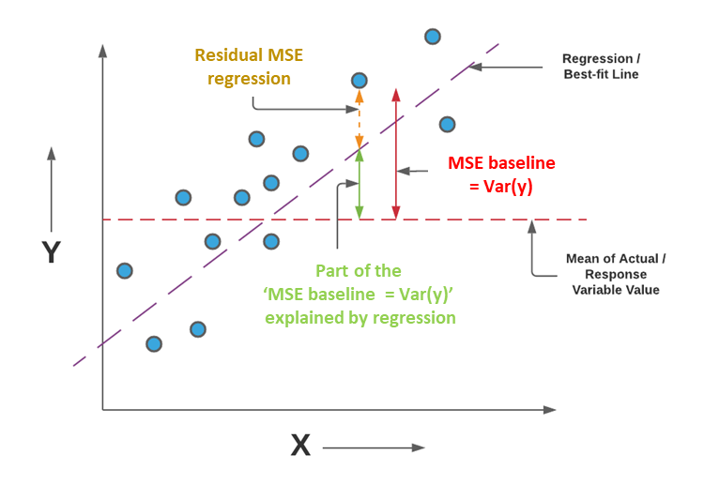
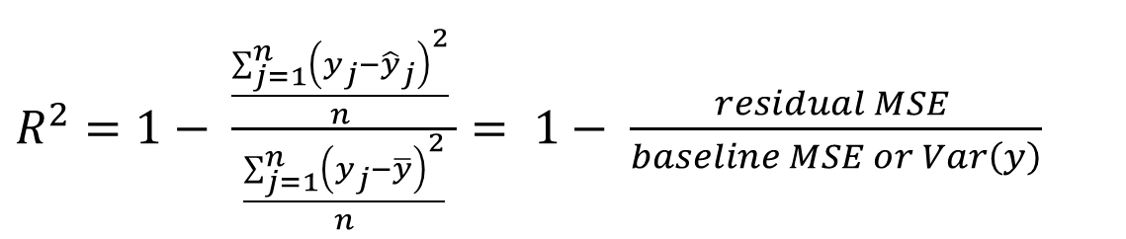
R-square or determination coefficient
Proportion or % of variance explained
Proportion of variance not explained by model
$R^{2}=1− \frac{\frac{\sum_{j=1}^{n}{{\left(y_{j}−{\hat{y}}_{j}\right)}^{2}}}{n} }{\frac{\sum_{j=1}^{n}{{\left(y_{j}−\overline{y}\right)}^{2}}}{n}}= 1− \frac{residual MSE }{baseline MSE or Var\left(y\right)}$
Complementary proportion (1-), i.e. Proportion of variance explained by model

Slide 19
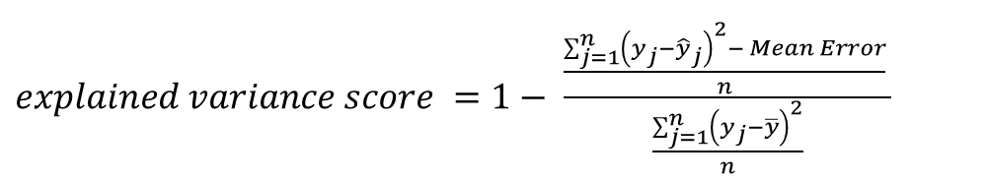
Sklearn’s ‘explained_variance_score’
Very similar to R²
Same but Mean Error substract from residual MSE-
If best-fit line reached, ME always = 0
Thus, almost always R² = ‘explained variance score’
Usefulness ?
$explained variance score =1− \frac{\frac{\sum_{j=1}^{n}{{\left(y_{j}−{\hat{y}}_{j}\right)}^{2}− Mean Error}}{n} }{\frac{\sum_{j=1}^{n}{{\left(y_{j}−\overline{y}\right)}^{2}}}{n}}$
ME = 0

Slide 20
Sklearn’s ‘explained_variance_score’
Explained variance score artificially corrects for this bias
Very similar to R²
Same but Mean Error substract from residual MSE-
If best-fit line reached, ME always = 0
Thus, almost always R² = ‘explained variance score’
Usefulness ?
When estimator is biased (model not yet converged)
If R² = ‘explained variance score’ → convergence reached
If R² < ‘explained variance score’ → convergence not yet reached
Non best fit line
ME ≠ 0
$explained variance score =1− \frac{\frac{\sum_{j=1}^{n}{{\left(y_{j}−{\hat{y}}_{j}\right)}^{2}− Mean Error}}{n} }{\frac{\sum_{j=1}^{n}{{\left(y_{j}−\overline{y}\right)}^{2}}}{n}}$
ME = 0

Slide 21
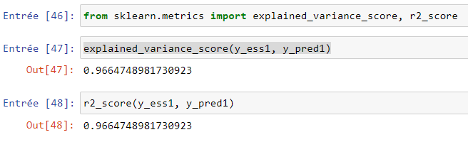
Sklearn

